Slide 1
Bus Route Management System

Slide 2
Background
Application Description
Public Transportation Challenges:
Introduction to challenges in managing public transportation.
Emphasis on efficient coordination for seamless operations.
Resource Management Importance:
Critical role of resource management in transportation.
Importance of optimal bus scheduling and operation.
Key Components:
Project focuses on drivers, buses, and bus routes.
Efficient management crucial for operational success.
presenter name

Slide 3
Background
Application Description
4. Automation for Efficiency:
Conventional manual systems' limitations.
Project goal: automate and optimize through a comprehensive database.
5. Project Objectives:
Design relational database for drivers, buses, and routes.
Explore non-relational database for alternative data modeling.
6. User-Friendly Interface:
Development of user-friendly interface.
Enhances accessibility and usability for administrators.
presenter name

Slide 4
Dataset Description
Driver Dataset:
Includes essential information about drivers, such as their names and license numbers.
Facilitates tracking and management of driver details for effective rostering.
Bus Dataset:
Captures details about each bus, including identification numbers, capacities, and maintenance schedules.
Enables monitoring and optimization of bus operations and maintenance.
t
3.Route Dataset:
Stores information on different bus routes, including names and start/end locations.
Essential for planning and coordinating routes within the transportation network.
4.BusRoute Dataset:
Establishes connections between buses and routes.
Facilitates efficient mapping of buses to their assigned routes for streamlined operations.
presenter name

Slide 5
Relational Database Implementation
presenter name

Slide 6
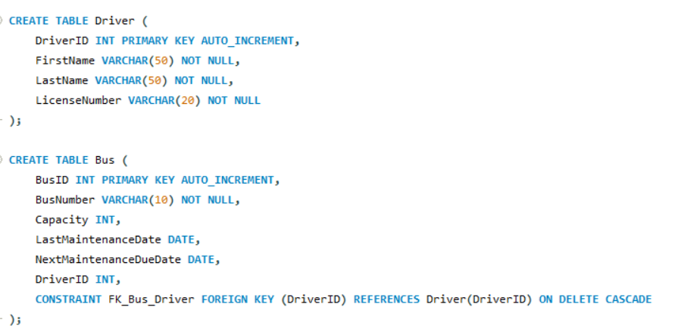
Schema
There are four separate tables showing relationship between different entities
Implemented using SQL workbench
And SQL server
presenter name

Slide 7
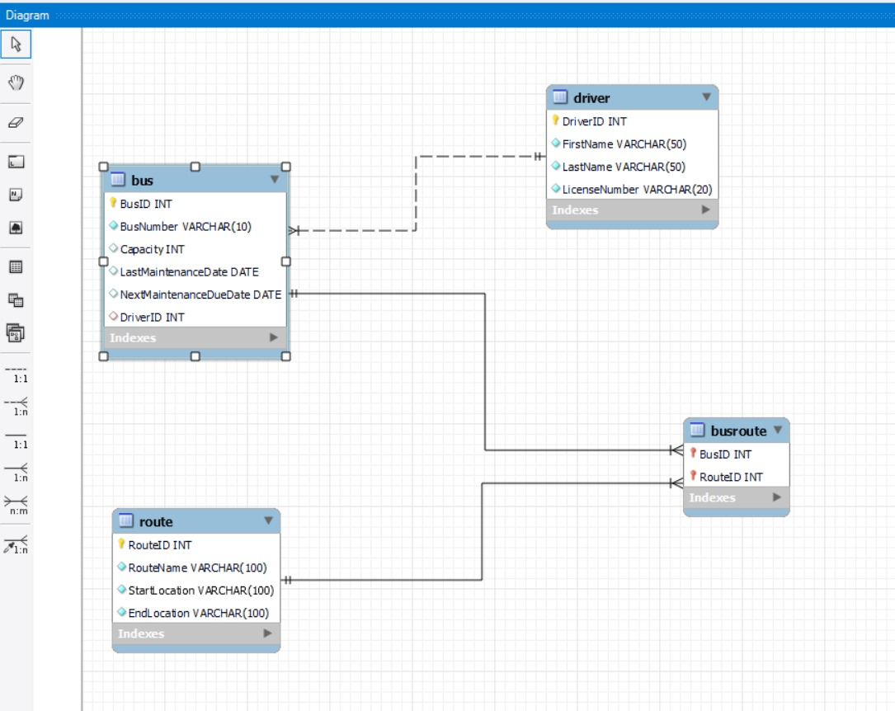
ER Diagram
presenter name

Slide 8
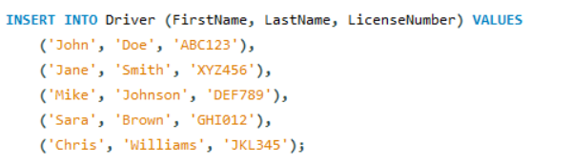
Functions
Implemented basic CRUD operations
Foreign Key with CASCADE:
Cascade option ensures that changes to the primary key (DriverID) in the Driver table propagate to related records in the Bus table.
Auto-Incrementation of IDs:
Implementation of auto-incrementation for primary keys (e.g., DriverID, BusID) to ensure unique identifiers.
Simplifies data entry and maintenance by automatically assigning incremental IDs to new records.
presenter name

Slide 9
Functions
Streamlined Record Insertion:
Auto-incrementation enhances the simplicity of adding new records, as the database manages unique ID assignment.
Demonstrating the ease of inserting new drivers, buses, and routes without manual ID assignment.
Integrity in Bus-Route Connections:
Establishing relationships between the Bus and Route tables using foreign keys (e.g., BusID and RouteID).
CASCADE option ensuring changes to primary key values in Bus or Route tables reflect in the BusRoute table, maintaining data consistency.
presenter name

Slide 10
NoSQL database Implementation
presenter name

Slide 11
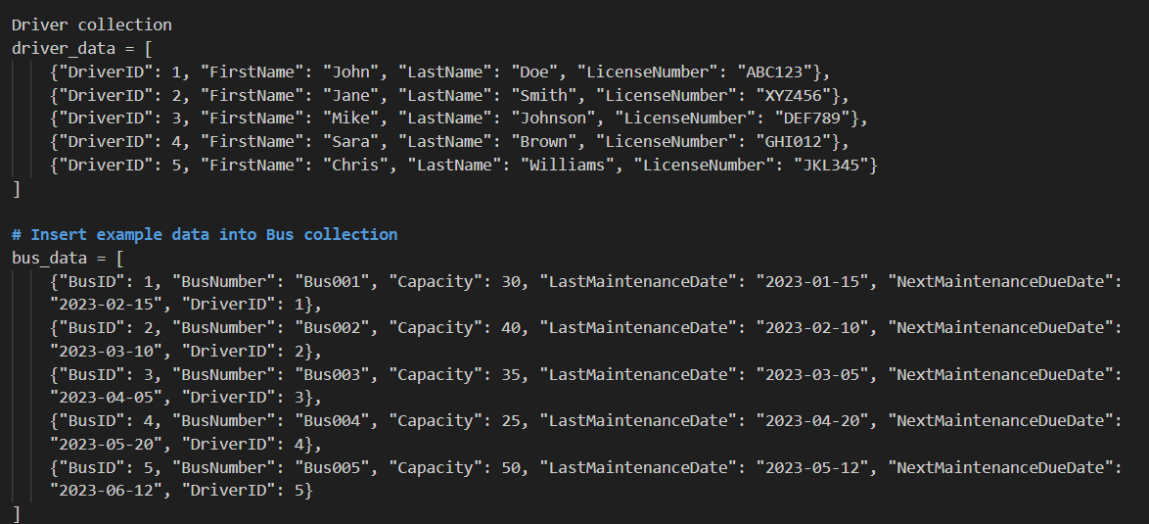
Collections
Implemented using MongoDB
4 basic collections Bus, Driver , Route and Bus route
presenter name

Slide 12
Comparison between SQL and NoSQL
Relational
Non-relational
Easy to implement CRUD operations because of foreign key association
Easy to increment id’s automatically
Have to remove all the occurrences manually from each collection because of lack of foreign key linkages
Have to supply id’s of bus,driver and routes while CRUD operation.
presenter name

Slide 13
Function Demos
presenter name

Slide 14
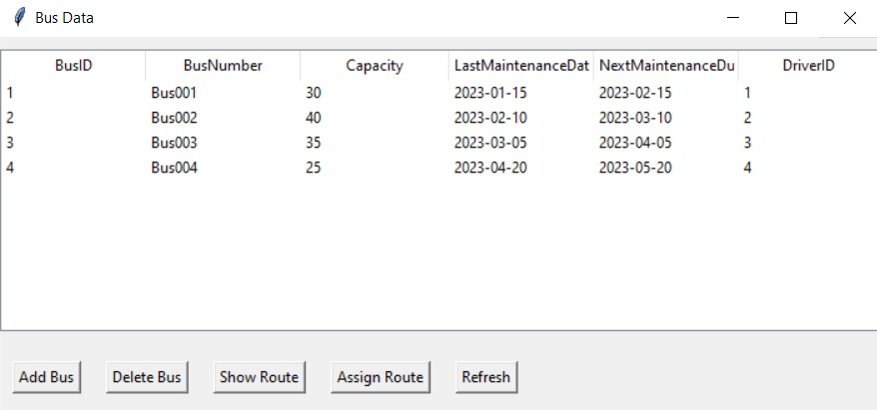
Bus section
Main screen of the bus section containing all the options to
add
delete
show
assign routes
presenter name

Slide 15
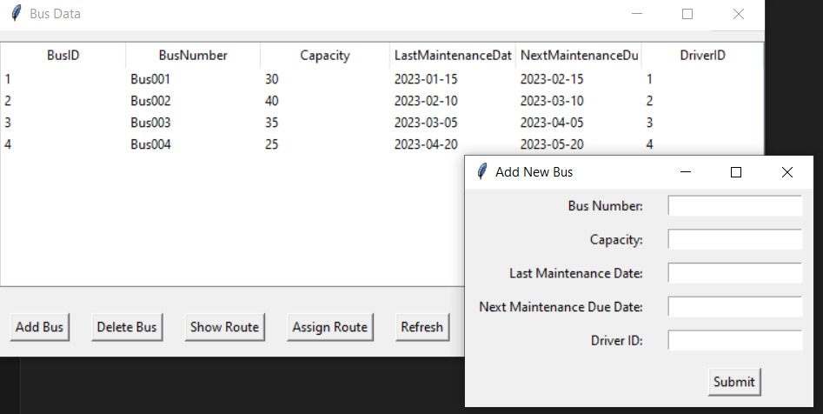
Add bus
Add bus takes in bus number, capacity and driver ID
If driverID is not available it will throw an error
presenter name

Slide 16
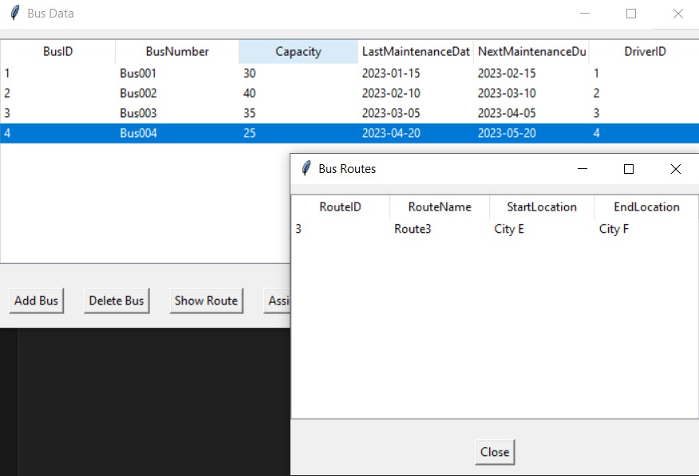
Show route
Shows all the routes that the bus is currently undertaking
presenter name

Slide 17
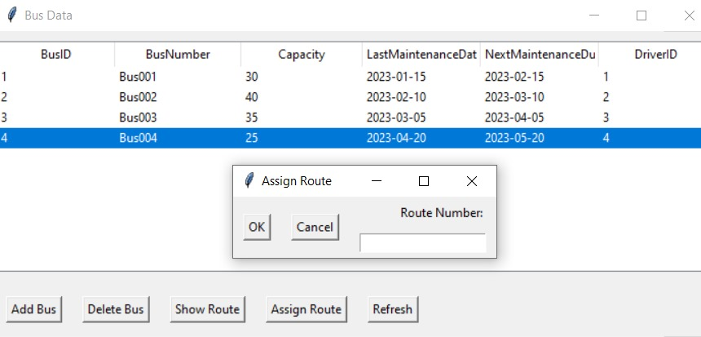
Assign Route
Checks all the available routes and assign the route that the user selects
presenter name

Slide 18


